Slide 1

Group Members: 1. Huzaifa Kamal 21P-0500
Aggregate Calculator

Slide 2
Contents of the Project
Classes | In classes we discuss about public access specifier, constructor,Destructor and access specifier.
Inheritance | Parent class,child class.
Exceptional Handling | Try,catch.
Conditions | If,else if,else,while .
Object | Make object with class name

Slide 3
Introduction

Slide 4
Description
1. An aggregate calculator is a tool used to calculate the overall aggregate or grades in various subjects or courses. It is commonly used in educational institutions, such as schools and universities, to determine a student's overall performance.
2. Once the weights or credits are assigned the aggregate calculator computes the weighted average of the individual scores or grades obtained in each subject or course. The result is a single aggregate score, typically represented as a percentage or a grade point average (GPA) which reflects the overall performance of the student.
3. Some aggregate calculators may also consider additional factors such as bonus points for extracurricular activities or penalties for poor attendance . These factors can further influence the final aggregate score.

Slide 5
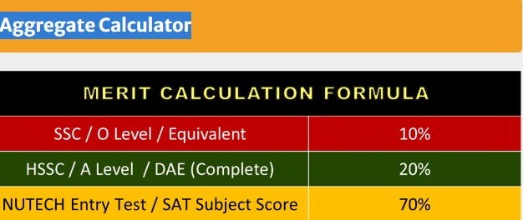

Slide 6
Applications
Education Institutions
Job Applications
Scholarship Applications
Educational institutions use aggregate calculators to determine student’s final grades or cumulative scores based on their performance in different subjects, modules, or semesters. This helps in evaluating students overall academic progress and making decisions regarding promotions, awards, or scholarships etc.
In certain professions or job positions, employers require applicants to submit their academic performance or calculate their aggregate scores from specific qualifications. An aggregate calculator assists applicants in determining and presenting their cumulative scores effectively during the job application process.
Scholarships are often awarded based on academic achievements. An aggregate calculator helps students calculate their overall performance and aggregate scores, which are essential for qualifying and applying for scholarships.

Slide 7
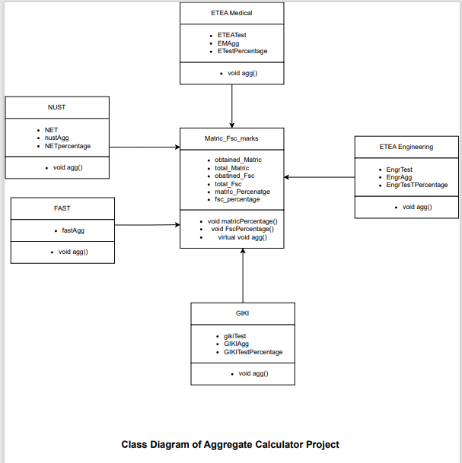
CLASS DIAGRAM

Slide 8
Thank You

